Slide 1
Resolving Scheduling Woes
401 Senior Project
Annie Flora, Amelia Jay, Liam Namba, Cristalina Nguyen, Sophia Prochnow, Christian Santander

Slide 2
The Problem
LAC+USC psychiatry residency program has 24 residents who rotate through the facility under Chief Resident Dr. Kelly Jones.
Dr. Jones is responsible for the creation of a call schedule over multiple wards, patient time-off requests, and scheduling constraints for the hospital.
Notes:
ANNIE
LAC (Los Angeles County)+USC psychiatry residency program has an inpatient locked facility at Augustus Hawkins Hospital. During the course of the year, 24 residents rotate through the facility (interns and second-year residents). Chief resident of this site is responsible for the creation of a call schedule for the year which takes into account different responsibilities

Slide 3
100
HOURS
Notes:
LIAM
“Ho. Ly. Shit. She says maybe 100 hours when she totals all the time (for the year). Insane.” - FORNEY SEPT. 2019

Slide 4
“We want to create a webapp that can take the residents’ preferences and generate a call schedule using constraints given, to both accelerate and automate the process”
Notes:
LIAM

Slide 5
Hopes and Requirements
MVP (Minimum Viable Product)
Minimum # of different shifts
2 month rotation block
Vacation requests
Balancing resident experience per ward
Future Phases
Allow residents to swap shifts without going through the admin
Ability to set constraints on groups instead of individuals
Scale to broader use cases
Notes:
LINA
For MVP (or minimum viable product which is basically the first iteration or launch of the product), we will fulfill the baseline requirements that Dr. Jones asked for. These include
Having a minimum number of people on the 4 different shift types:
Day float (person on call during the day when the rest of the team members leave)
Night float (person on call who covers the entire hospital overnight)
Long call and short call (people who cover the hospital over the weekend)
Each resident will rotate over the course of a two month block
Be able to take vacation block requests into account if possible
Balance each ward with second and first year residents so that each ward is equivalent in terms of resident knowledge/experience
In future phases a couple things that we would like to accomplish will be to:
Allow residents to autonomously swap shifts without needing approval from Dr. Jones
Setting constraints on groups of people rather than each person individually
Scaling to broader use cases - this includes expanding to other areas of the hospital/other hospitals as well as other types of businesses that need to schedule groups (like a retail business with Sales Associates, Managers, etc.)

Slide 6
Impact
Saving TIME and MONEY
Reduces time spent by Dr. Kelly on scheduling
Reduces errors in schedule by making sure constraints are satisfied without brute force/trial and error methods
Opportunity for scaling would reduce time spent on scheduling for other businesses
Notes:
SOPHIA
Her time can be spent on other things
Increases revenue for the hospital by decreasing time spent by Dr. Kelly Jones on scheduling brute force
Can save time and $ for LOTs of businesses in the future once scales out (esp if schedulers are being paid by the hour b/c that will have a direct visible impact)

Slide 7
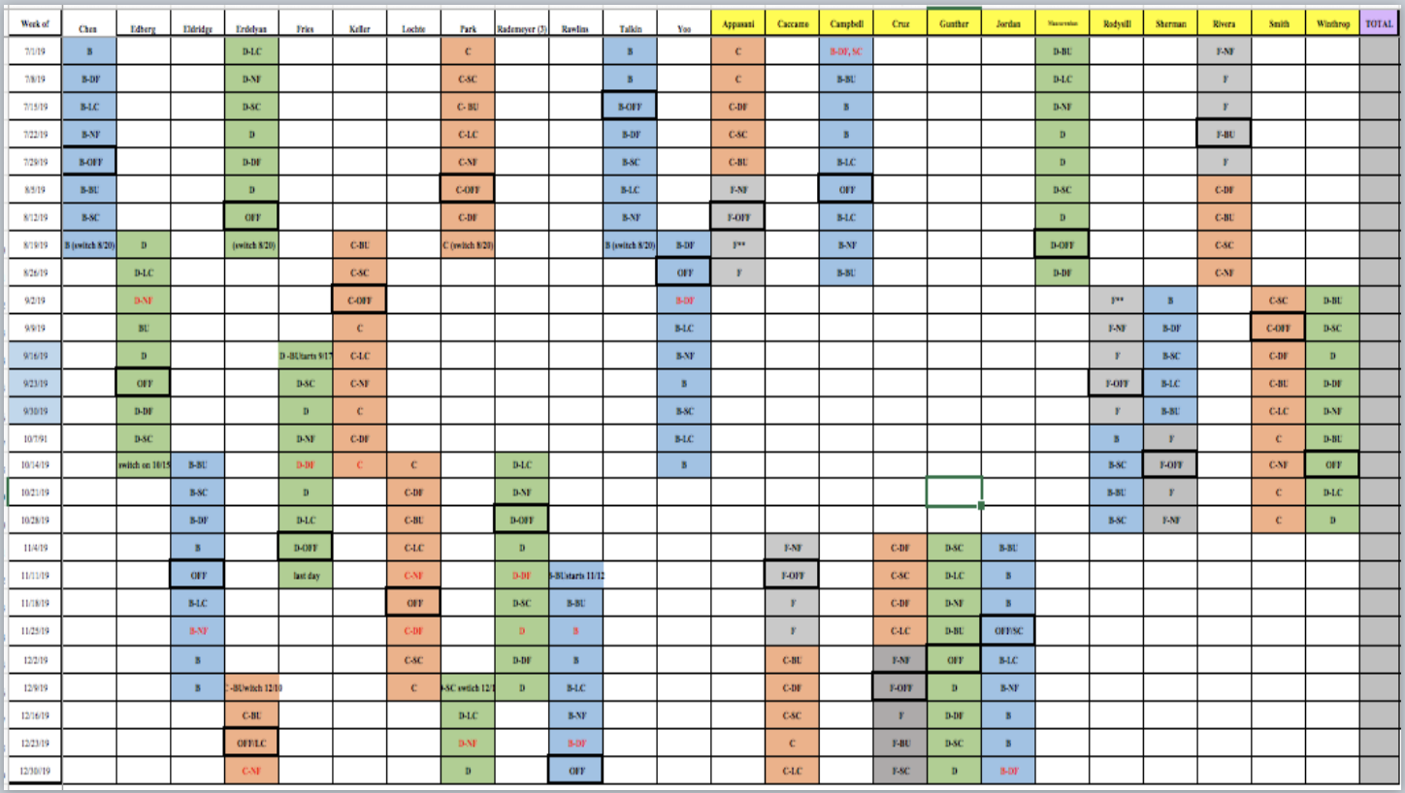
Current Model
#STRESSFUL!
Notes:
CHRIS

Slide 8
Relevant Coursework for the project
Databases
Storing and using resident and scheduling data
Interaction Design
Web development skills
UX Design
Algorithms
Constraint Propagation
Artificial Intelligence
Forney
Maximizing expected utility
Notes:
CHRIS

Slide 9
Product Development Plan
Biweekly Sprints:
Planning
Development
Iteration
Notes:
AMELIA
We will have a daily standup to discuss our progress and bring up any challenges we’re facing. We will be meeting weekly with Forney and we are on a biweekly sprint schedule. We will also be meeting with Dr. Jones regularly throughout this process to better understand her needs and to make sure that the product we create aligns with her vision.

Slide 10
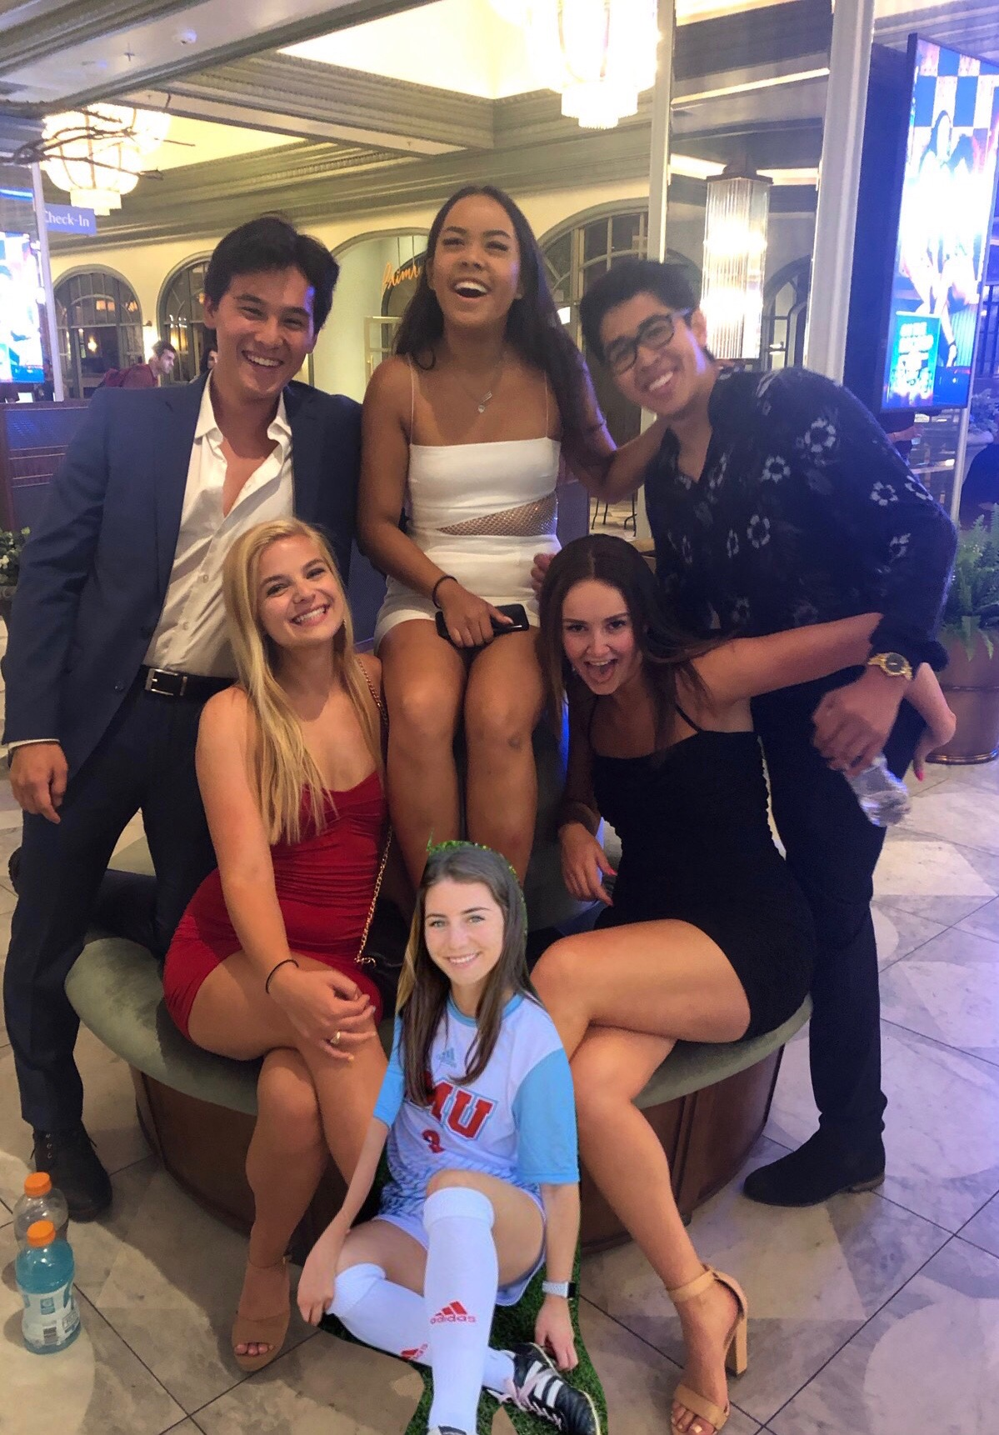
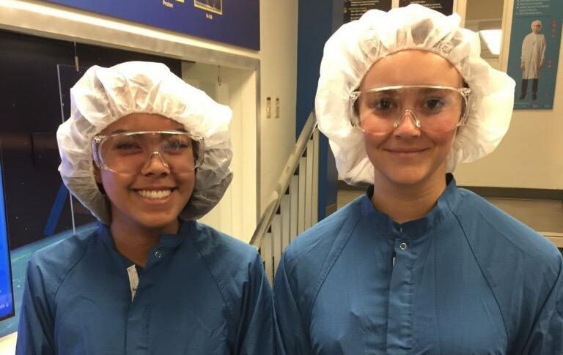
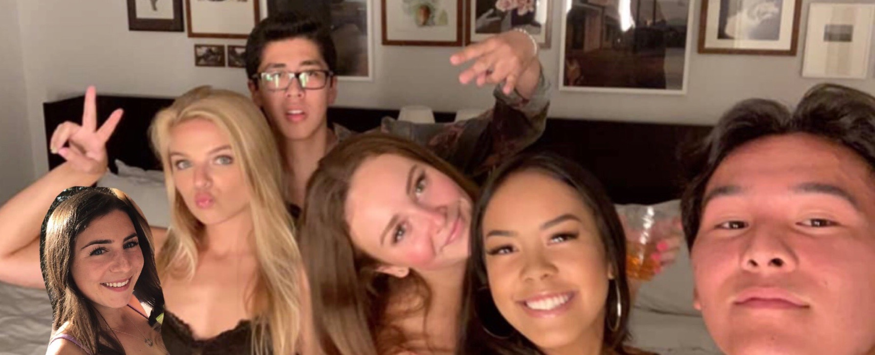
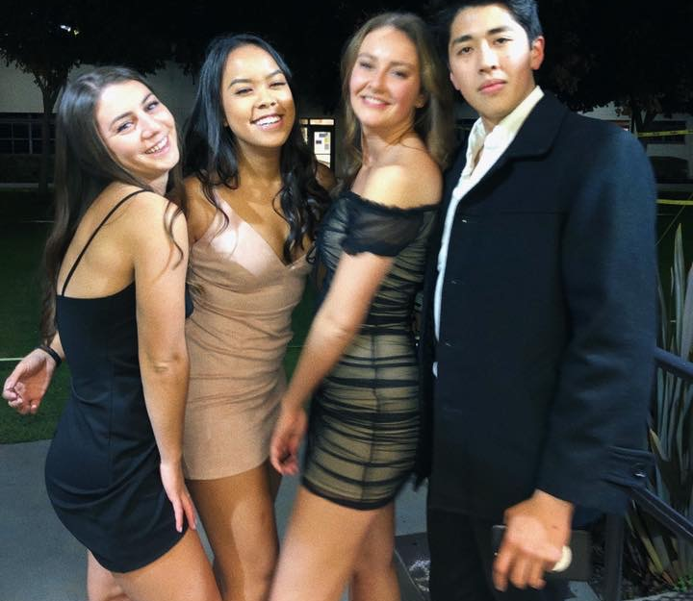
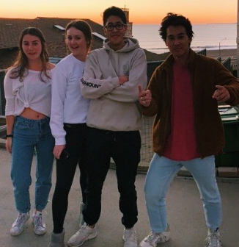
thanks!
Love, Fuzz

Slide 12
Extra graphics

